Slide 1
Python for Data Analysis: The Tools and Techniques
Premkumar Chandra Shegaran

Slide 2
Agenda
Introduction
Python Crash Course
Numpy
Pandas Basics
Lunch/Half time break
Pandas Exercise
Visualizations

Slide 3
About the Speaker

Slide 4





Professional Experience

Slide 5


Education

Slide 6





Seminars/Talks
Mentorship

Slide 7
Your turn..
Academics?
Business owners?
Data scientists?
Experience with data?

Slide 8
Welcome to ALT.labs Series 1

Slide 9
About
Monthly community event driven by passionate people to thrive in industry 4.0
Addresses the on-demand skillsets and technologies needed to survive in the current revolution: IOT, Cloud Computing, Robotics, AI&Big (Extreme) Data, and Cyber Security
To empower Malaysia to become a tech-driven state
To share and exchange knowledge, solve real world problems and most importantly, create an AWESOME community and to DISRUPT

Slide 10
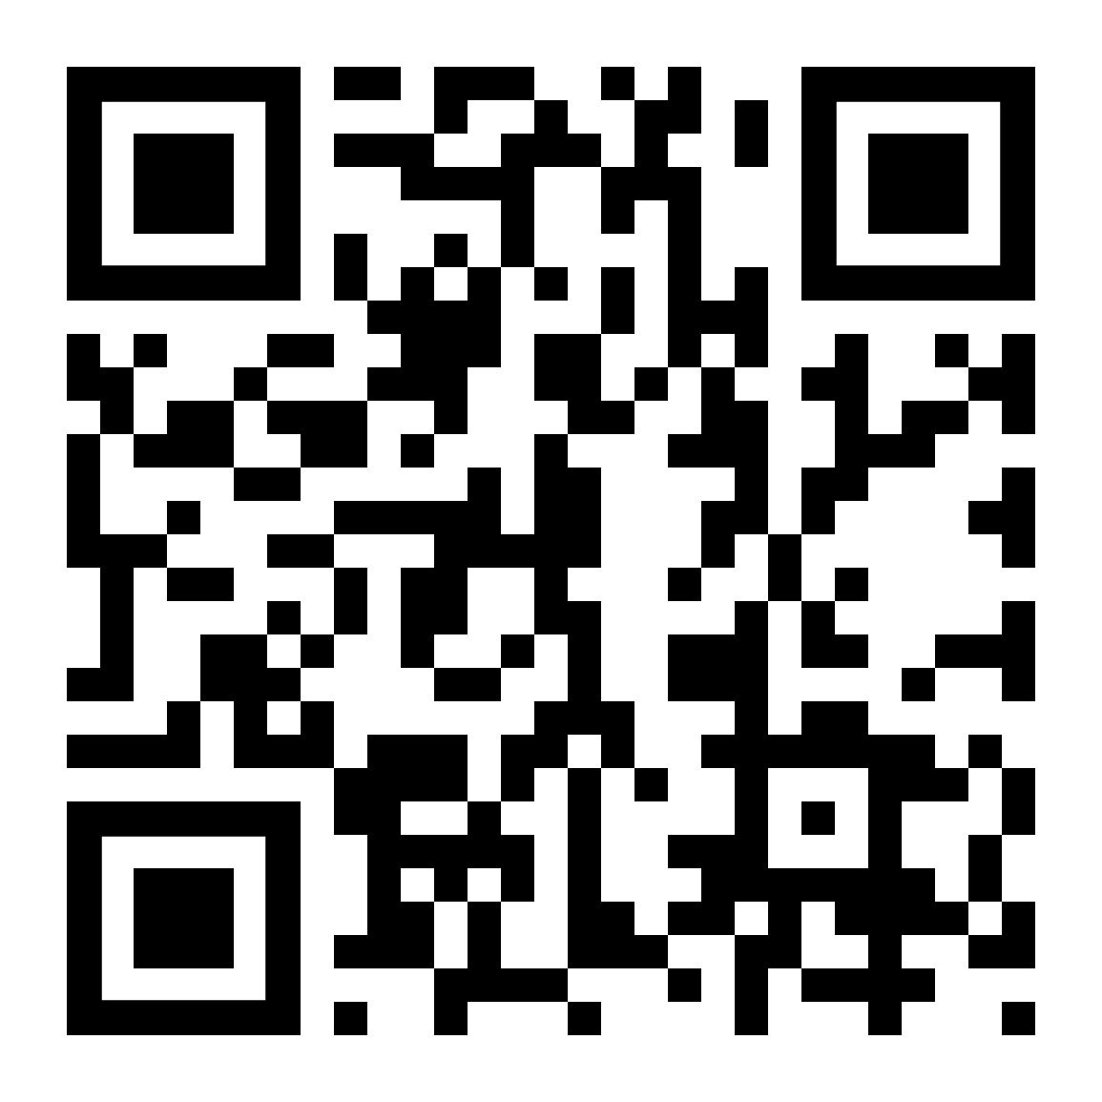
What you need to do..
Support us and the community by participating in the monthly co-labs
Join our LinkedIn site: https://bit.ly/2PX5qeR

Slide 11
Python for Data Analysis

Slide 12
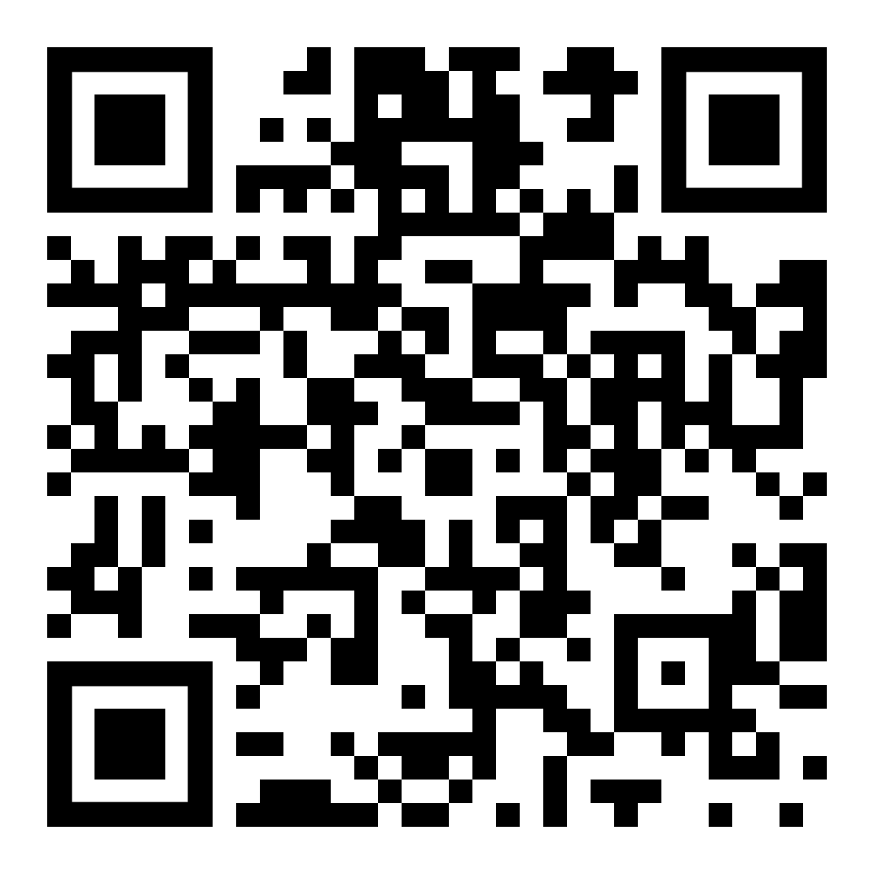
Download Course Materials
Github page: https://bit.ly/2JyDTz5

Slide 13
Advantages of Python
Developers can learn it quickly
Typically involves less code
Syntax is easier to read
Utilized by every major tech companies
Huge amount of open source libraries

Slide 14
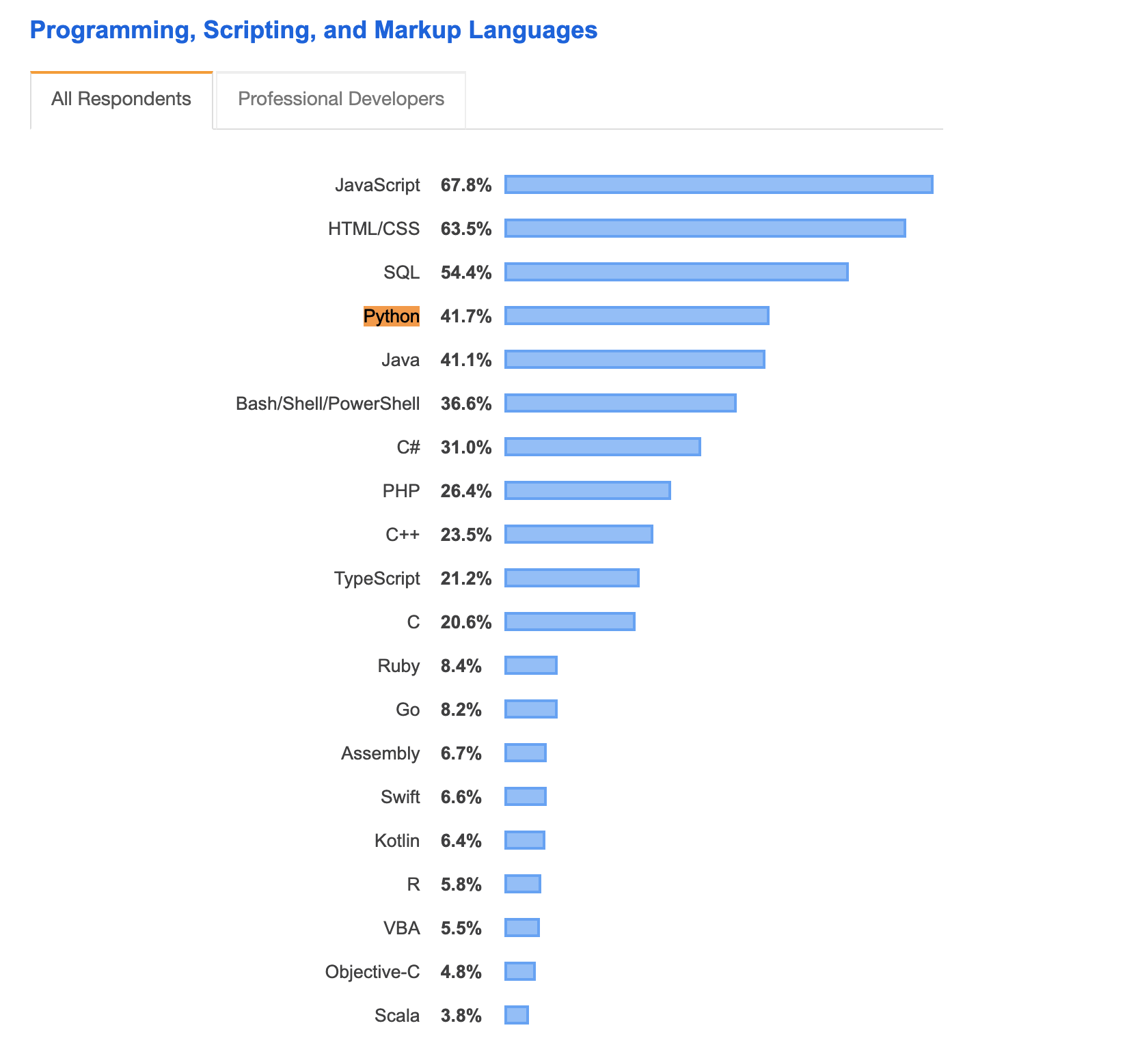
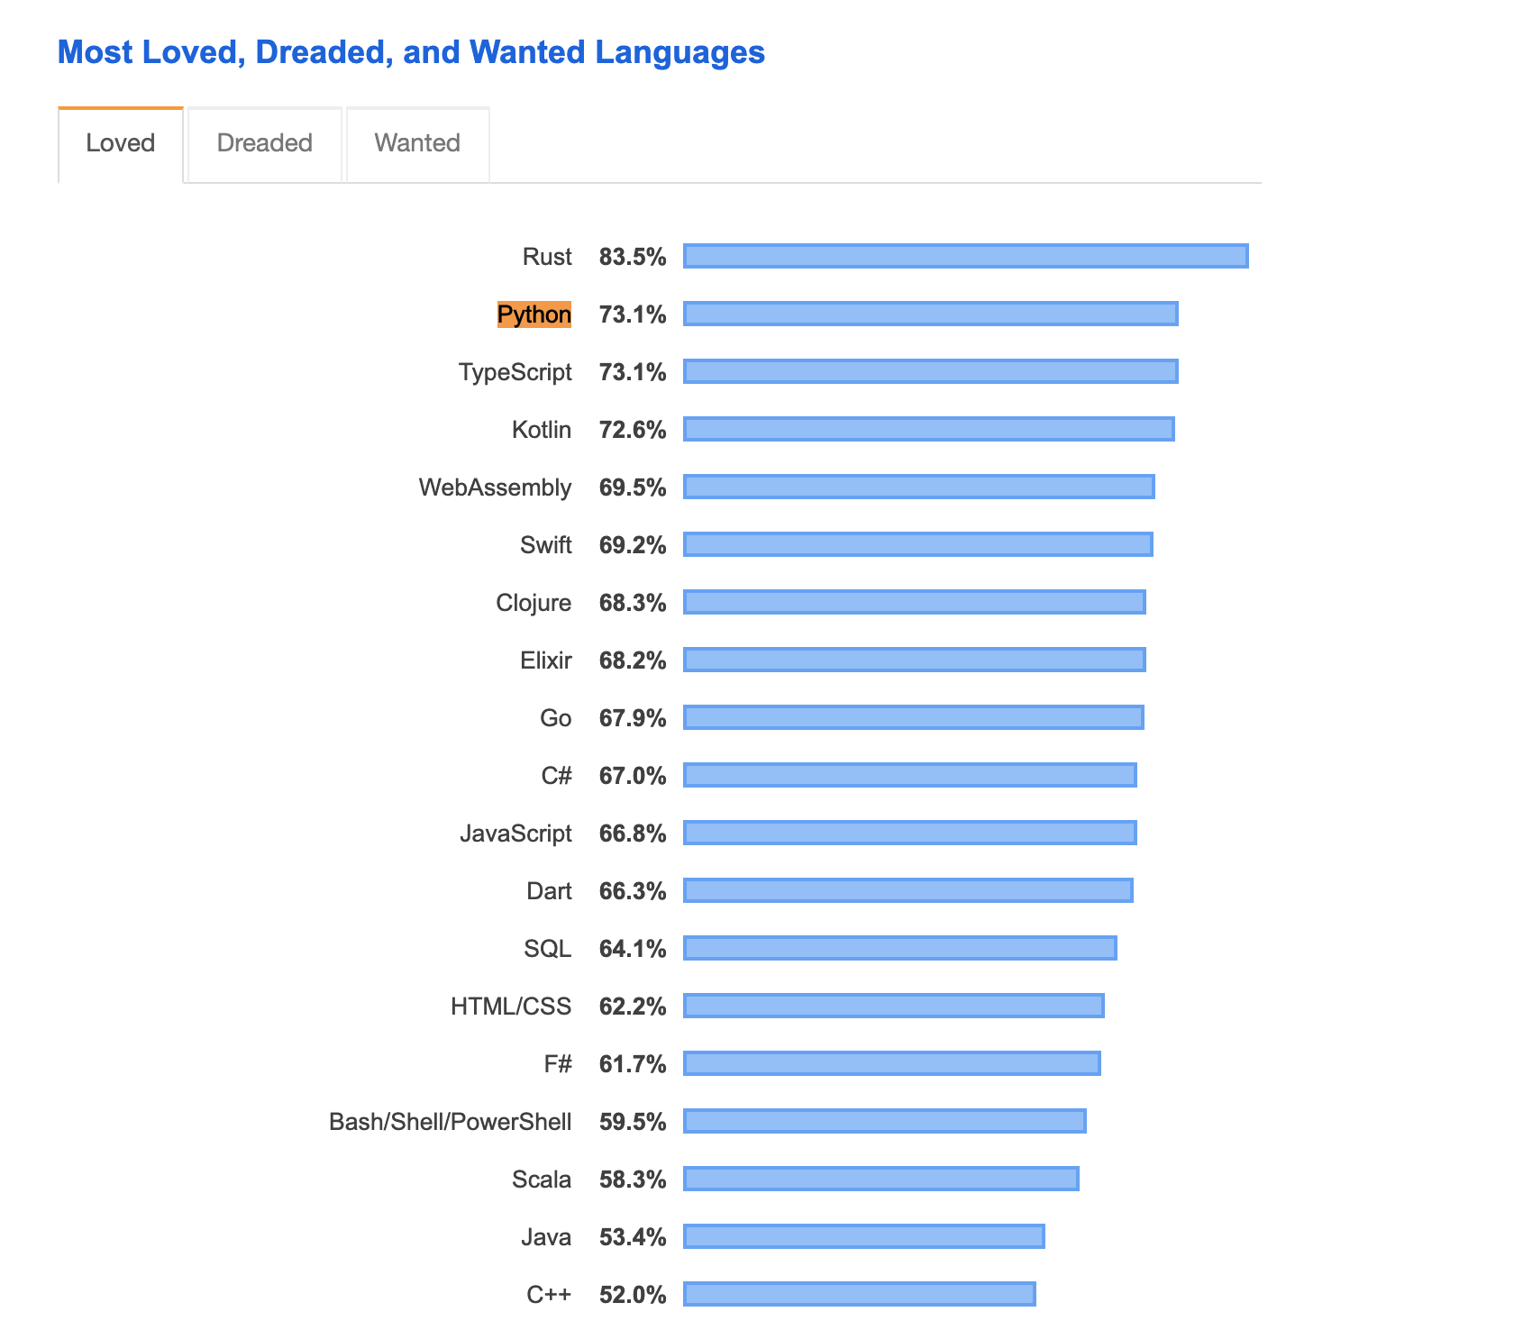

Slide 15
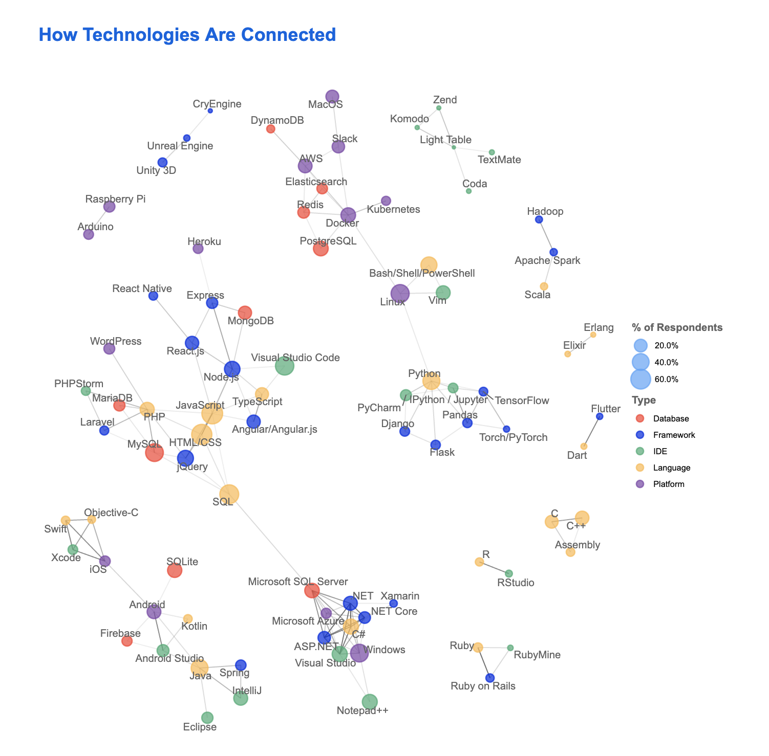

Slide 16
Python Installation

Slide 17
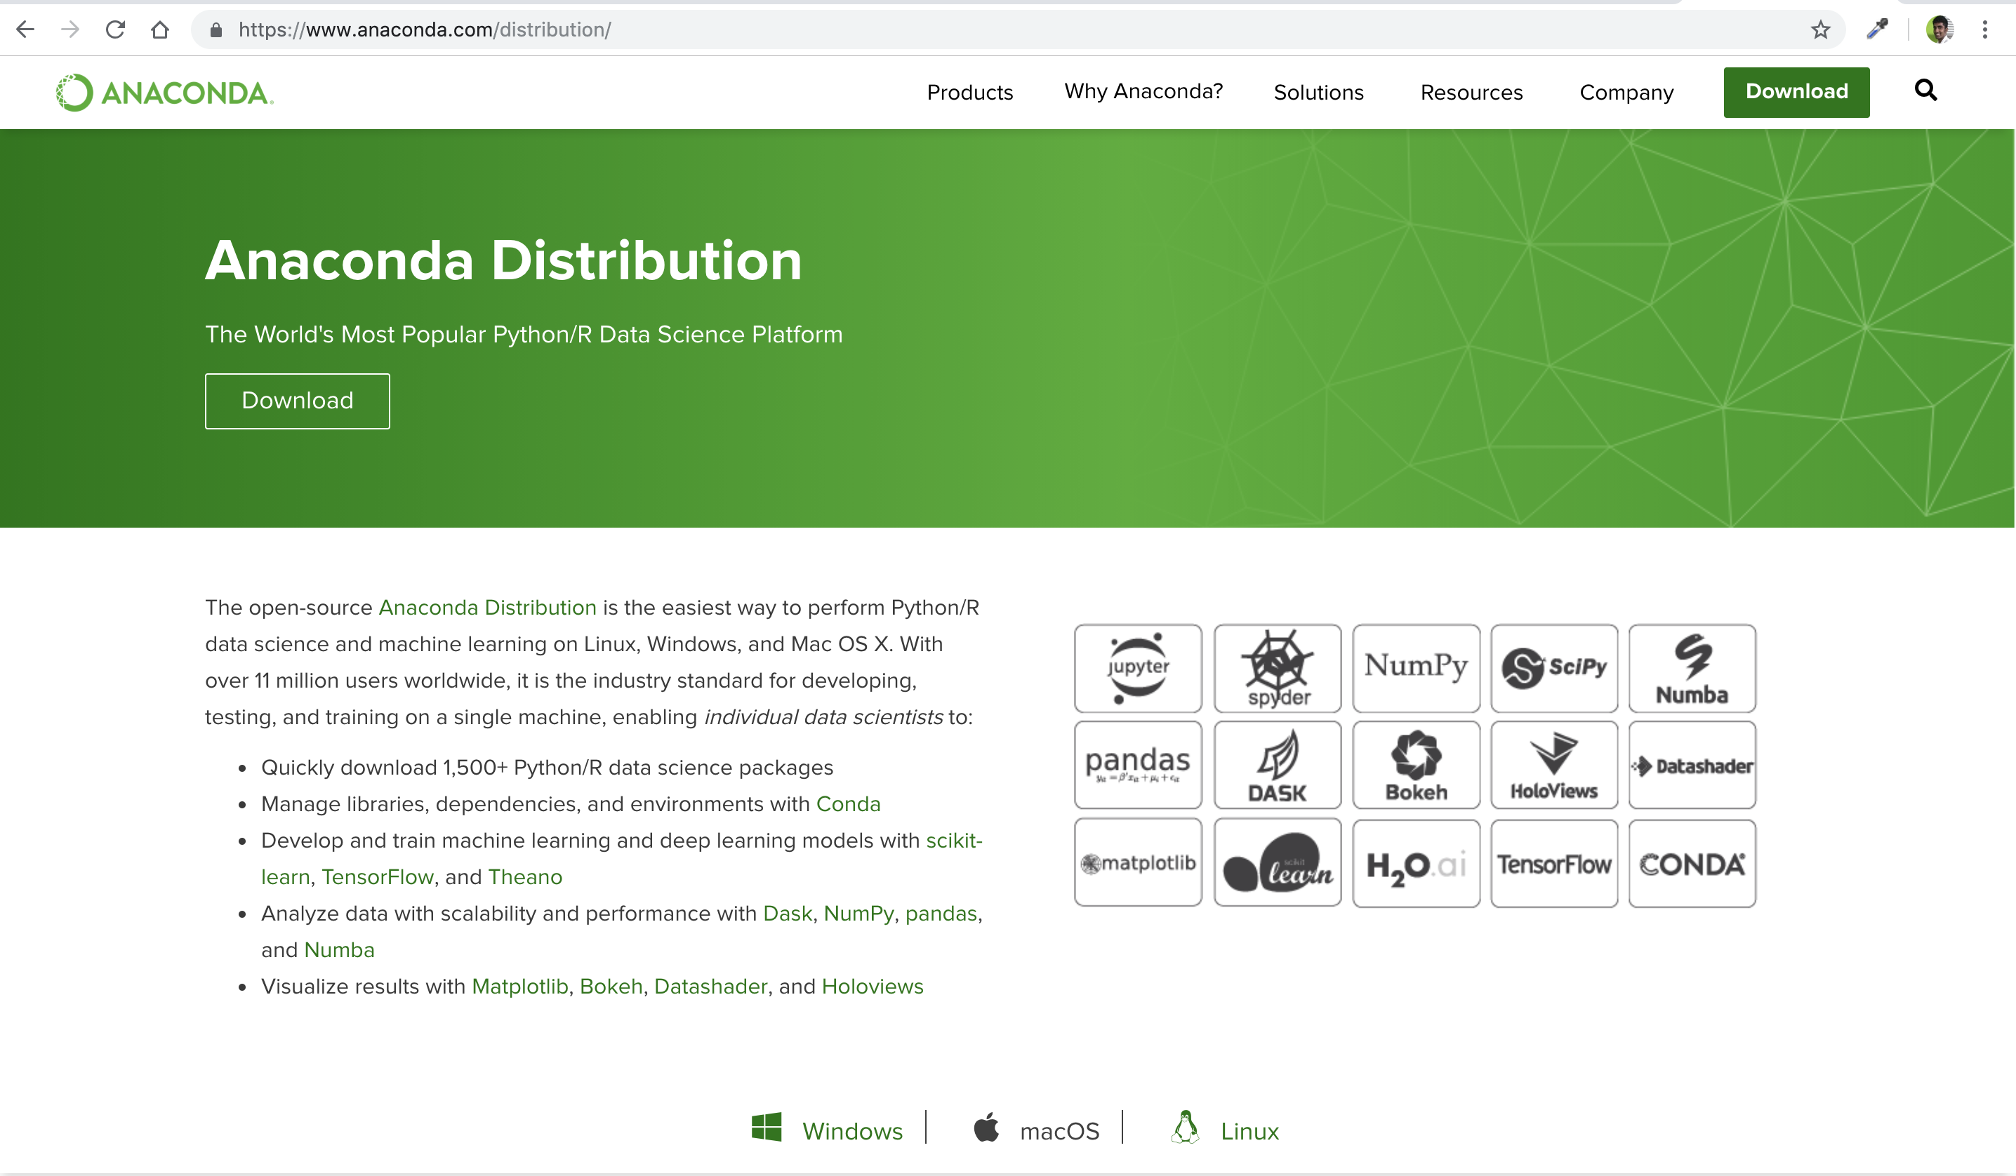
Install Python & Jupyter

Slide 18
Development Environments
Text Editors - Atom, Sublime, TextWrangler, Notepad++
Full IDEs - Pycharm, Spyder, Visual Studio Code
Notebook Environments - Jupyter Notebooks, IPython environments
Command Line Interface/Terminal - Bash Shell

Slide 19
Development Environments
Text Editors - Atom, Sublime, TextWrangler, Notepad++
Full IDEs - Pycharm, Spyder, Visual Studio Code
Notebook Environments - Jupyter Notebooks, IPython environments
Command Line Interface/Terminal - Bash Shell

Slide 20
Python Crash Course – 1.5 hours
Data Types
If, elif, else
For loops, enumeration, list comprehensions
Functions
Map, reduce, filter, zip and Lambda Expressions
Python Regex

Slide 21
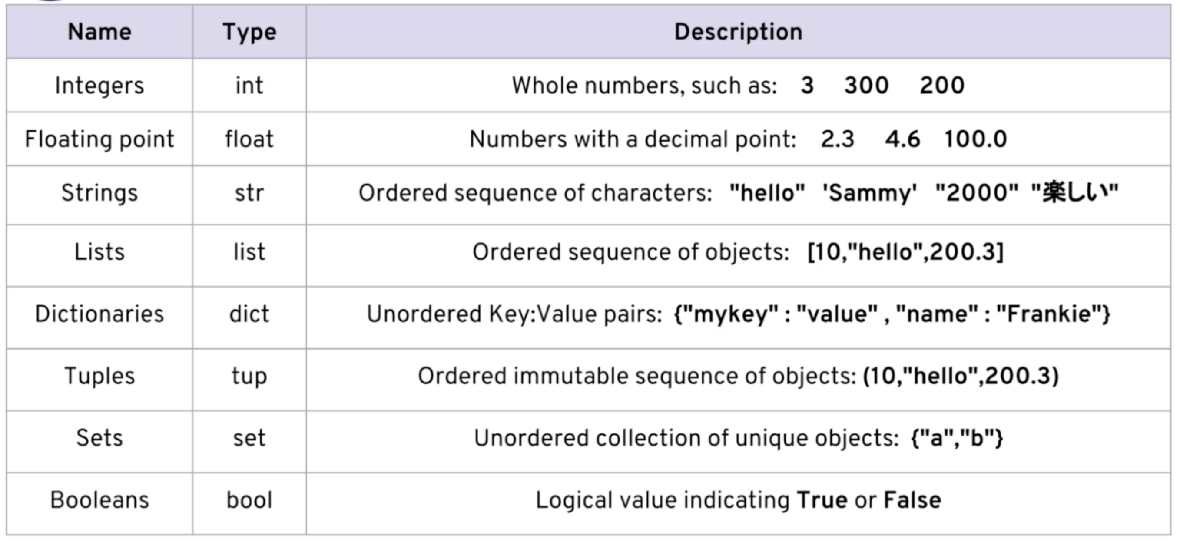
Python Data Types

Slide 22
Python Data Science
Numpy
Pandas
Matplotlib and Seaborn

